Slide 1
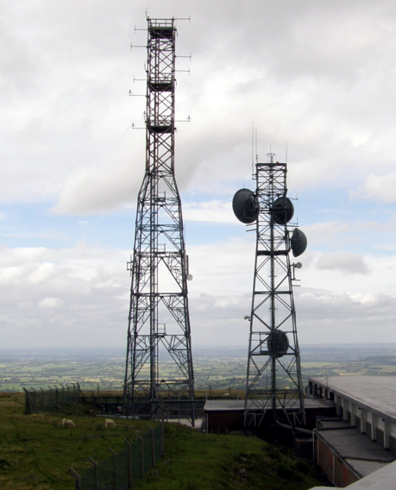
Cellular Concept
Why not a large Radio tower and Large Service area?
The design objective of early mobile radio systems was to achieve a large coverage area by using a single, high powered transmitter with an antenna mounted on a tall tower.
Good coverage, but it was not possible to reuse those same frequencies throughout the system
Limitation in the Number of simultaneous users.
Mobile Handsets would have greater power requirements.

Slide 2
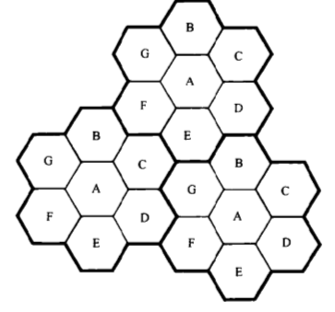
Cellular Concept
Major break through in solving the problem of spectral congestion and limited capacity
Cellular concept- small cells with frequency reuse
Advantages:
Low power handsets
Increases system capacity with frequency reuse.
Drawbacks
Cost of the cells
Handoffs between the cells must be provided.
Adjacent Channels
4
5
3
1
6
2
7
Courtesy to Theodore S. Rappaport
©2002, 1996 Prentice Hall PTR
Co- Channels

Slide 3
Cellular Systems – Basic Concepts
Each base station is allocated a portion of the total number of channels .
Neighboring base stations are assigned different groups of channels so that the interference between base stations is minimized.
A switching technique called Handoff enables a call to proceed uninterrupted when user moves from one cell to another.
Cell size can be reduced if the transmitted power is reduced. (Transmitted power is a factor which will decide how big the cell size should be)

Slide 4
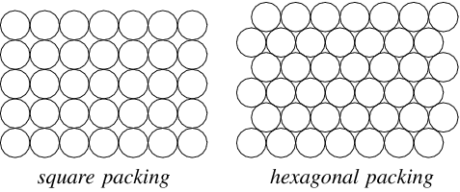
Choosing Shape for a Cell
Circle Shape
Gaps

Slide 5
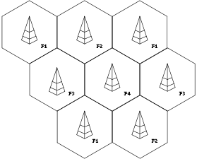
Choosing Shape for a Cell
Hexagon has the largest area .
Approximates the shape of circle
It has been universally adopted .
It also permits easy and manageable analysis of a cellular system.
Hexagon Shape
Courtesy to Theodore S. Rappaport
©2002, 1996 Prentice Hall PTR

Slide 6
Frequency Reuse
Cellular radio systems rely on reuse of the channels through out the coverage area.
Each base station is allocated a group of radio channels to be used with in the small geographic area of its cell.
Neighboring base stations are given different channel allocation.
The same group of frequencies is re used to cover another cell separated by a large distance to minimize co-channel interference .
Illustration of Cellular Frequency
Reuse concept.
Courtesy to Theodore S. Rappaport
©2002, 1996 Prentice Hall PTR

Slide 7
Cellular Capacity
Let T = Total number of Duplex channels.
K cells = Size of each cluster
N= T/k = number of channels per cell.
For a specific geographic area, if clusters are replicated M times , then the total number of channels
- System capacity = M x T (Proportional to M)
- K depends on how much interference can be tolerated by base stations while maintaining a sufficient quality of communication
- If the cluster size is reduced, more clusters are required to cover a given area and hence more capacity.

Slide 8
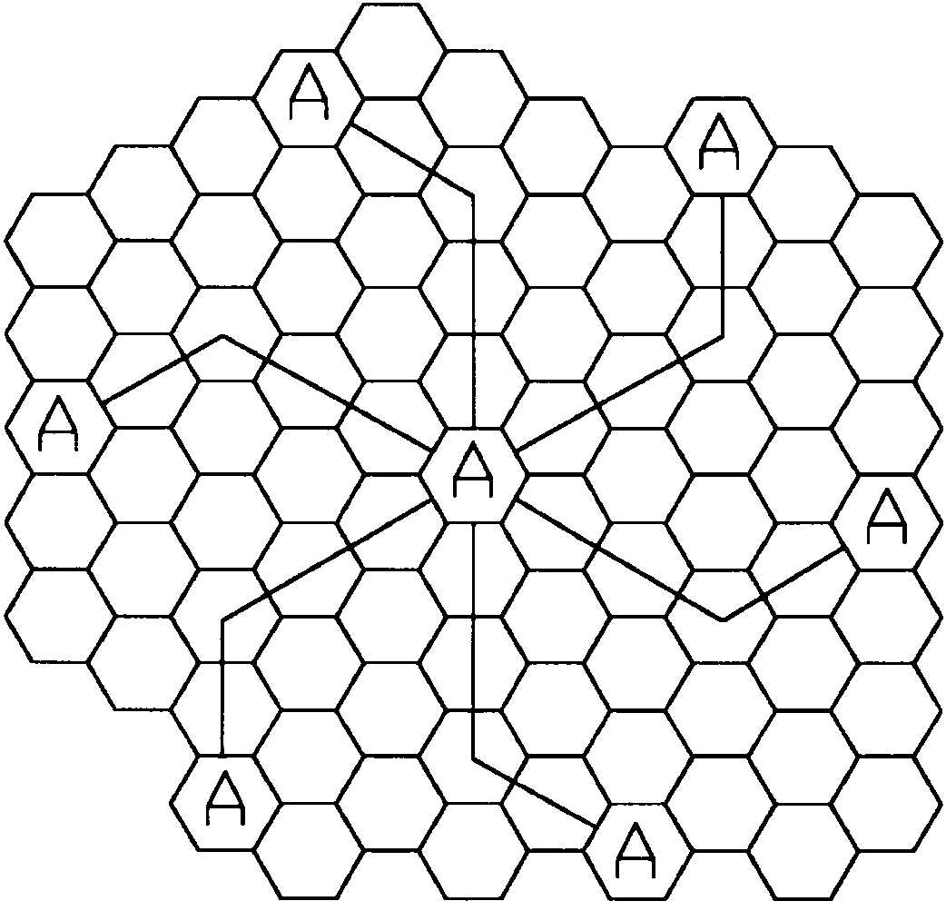
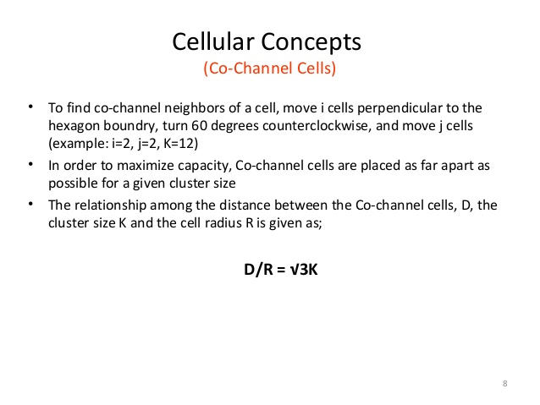
Co-channel cells in a cellular system
K= i²+ij+j²
i=3 and j=2
Method of co-channel cells in a cellular system
Courtesy to Theodore S. Rappaport
©2002, 1996 Prentice Hall PTR

Slide 9
Problems
Spectrum allocated to wireless system- 40Mhz
Simplex channel bandwidth for voice and control channel -25Khz
Cluster size =4
Bandwidth allocated for control channel = 1Mhz
Number of channels per cell ?
Number of control and voice channels in each cell?
Solution.
Channel bandwidth = 25KHz * 2 simplex channels = 50KHz duplex channels.
No. of available channels = 40000/50 = 800
For N = 4, total number of channels available per cell = 800/4= 200.
1MHz – control channels.
There fore 1000/50 = 20 control channels out of 800 channels are available.
For N=4, we can have 5 control channels and 195 voice channels.

Slide 10
Summary
Cellular concept increases the system capacity with frequency re-use.
Hexagonal cell is the shape considered for the cell as it is close to circle and has large area compared to other shapes.
Method of placing the co-channel cells in a geographical area to reduce the co-channel interference.

